Slide 1


Fraud Detection in Financial Transactions using Machine Learning
Team Member:
Sudheer Kumar Tatavalu
ba

Slide 2



Credit Card Fraud Detection: Leveraging Machine Learning
Combating Evolving Fraud Tactics
The Power of Machine Learning
Collaborative Approach
This project brings together expertise from various domains, including banking, data science, and machine learning, to develop robust fraud detection systems that protect financial institutions and their customers.
Credit card fraud has become a growing challenge in the digital banking era, as traditional detection methods struggle to keep up with the increasingly sophisticated tactics employed by fraudsters.
Machine learning offers a promising solution, enabling the analysis of vast transaction data to identify anomalies and detect fraudulent activities with greater accuracy and speed.

Slide 3
Enhancing Financial Transaction Security Through ML
1
Objective
2
Challenges
Detect fraudulent behavior in financial transactions efficiently using ML algorithms.
Address imbalanced data distributions, privacy concerns, and adaptive fraud techniques.
3
Tools
4
Models
Utilize Python-based tools like pandas, numpy, and scikit-learn for data preprocessing and model training.
Train various ML models including Random Forest and Logistic Regression to identify fraudulent patterns.
5
Analysis & Experimentation
6
Contribution
Conduct comprehensive analysis and experimentation on the dataset.
Aim to enhance transaction security in financial domains through ML.
7
Goal
Develop a reliable and scalable fraud detection system to safeguard financial transactions and maintain trust.

Slide 4

Machine Learning Approach
1
Data Preprocessing
Cleaning, transforming, and preparing the dataset for analysis and model training.
2
Model Building
Experimenting with various machine learning algorithms, including Logistic Regression and Random Forest.
3
Model Evaluation
Assessing the performance of the models using metrics like accuracy, precision, recall, and ROC-AUC.

Slide 5
Dataset Overview
Diverse Transactions
Imbalanced Data
The dataset contains credit card transactions from European cardholders, providing a comprehensive view of financial activity across the region.
The dataset is highly skewed, with only 0.172% of transactions being fraudulent, presenting a significant challenge for effective detection.
Temporal Information
Transaction Details
The transactions were recorded over a two-day period in 2013, allowing for analysis of potential fraud patterns within a specific timeframe.
The dataset includes features such as transaction amount and time, providing valuable information for machine learning models to identify fraudulent activities.

Slide 6

Challenges in Fraud Detection
1
Imbalanced Data
2
Privacy Concerns
The dataset has a low percentage of fraudulent transactions, making it difficult for models to learn the patterns.
Handling sensitive financial data requires careful consideration of privacy and security measures.
3
Adaptive Fraud Techniques
Fraudsters continuously evolve their methods, necessitating innovative approaches to stay ahead of the curve.

Slide 7




Methodology
Data Preprocessing
Machine Learning
Cross-Validation
Oversampling
Experimenting with a variety of algorithms, including Logistic Regression, Random Forest, KNN, Decision Trees, SVM, and XGBoost, to identify the top-performing model.
Using techniques like Repeated K-Fold and Stratified K-Fold to ensure robust model evaluation and prevent overfitting.
Applying methods such as Random Oversampling, SMOTE, and ADASYN to address the imbalanced nature of the fraud dataset.
Cleaning and transforming the raw data to prepare it for modeling, including handling missing values, scaling features, and encoding categorical variables.

Slide 8
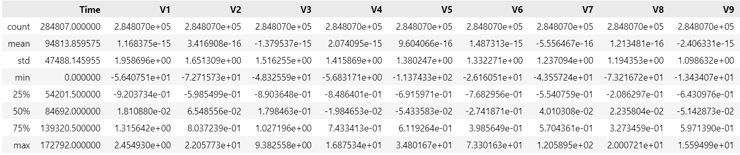
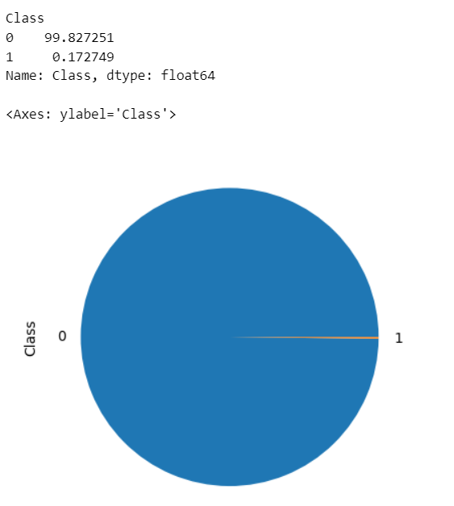
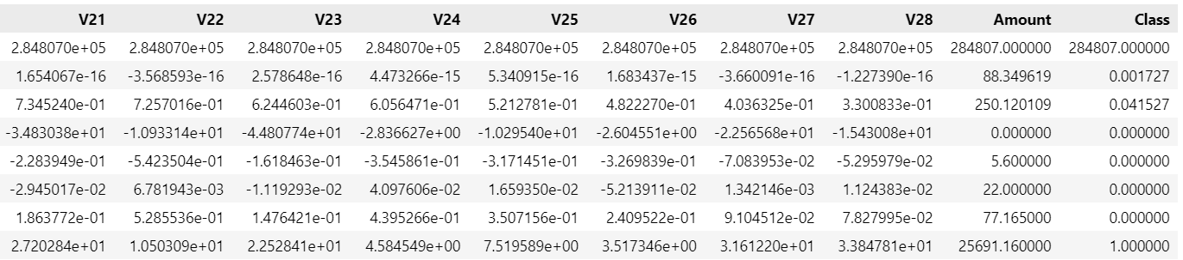
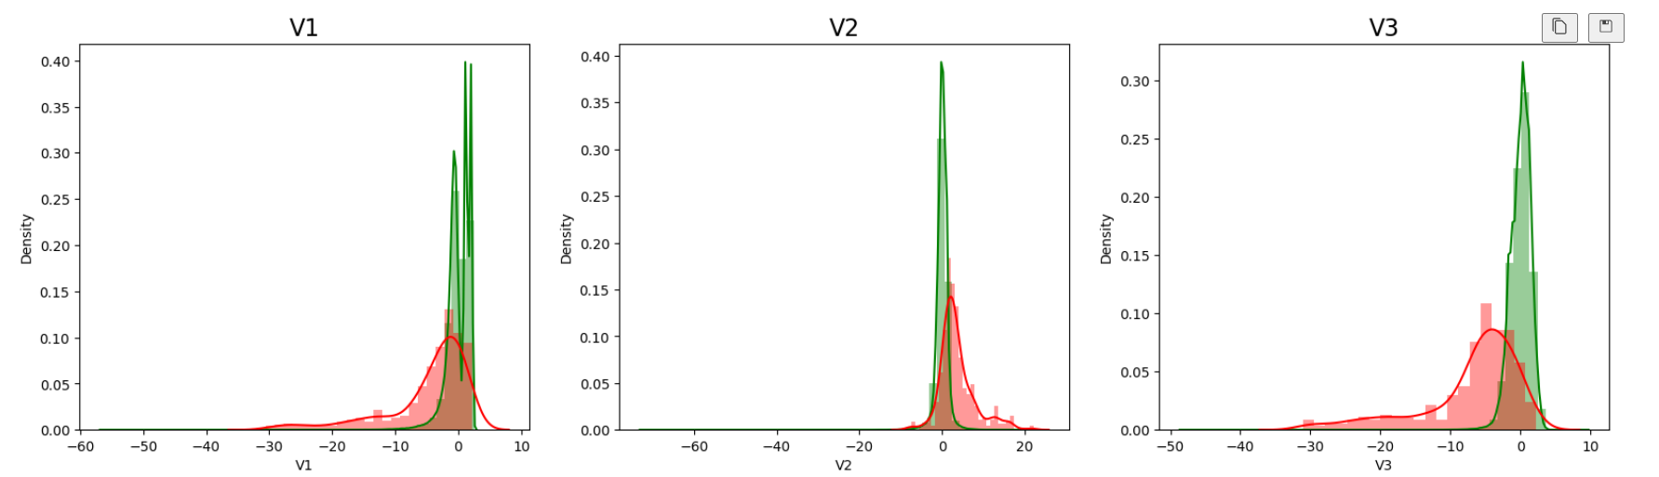
Data Preprocessing

Slide 9
ML Models:
logistic regression,
random forest,
k-nearest neighbors,
decision trees,
SVM, and
XGBoost to build the model
Model building using different techniques and strategies such as
Repeated KFold Cross Validation,
StratifiedKFold Cross Validation,
Random Oversampling with stratifiedKFold CV,
SMOTE Oversampling with stratifiedKFold CV,
ADASYN Oversampling with stratifiedKFold CV,
Hyperparameter tuning.

Slide 10
Oversampling Techniques
Random Oversampling
SMOTE Oversampling
ADASYN Oversampling
Randomly selecting examples from the minority class and adding them to the training dataset.
Generating synthetic examples of the minority class to balance the dataset.
Adaptively generating minority class examples based on their difficulty to learn.

Slide 11
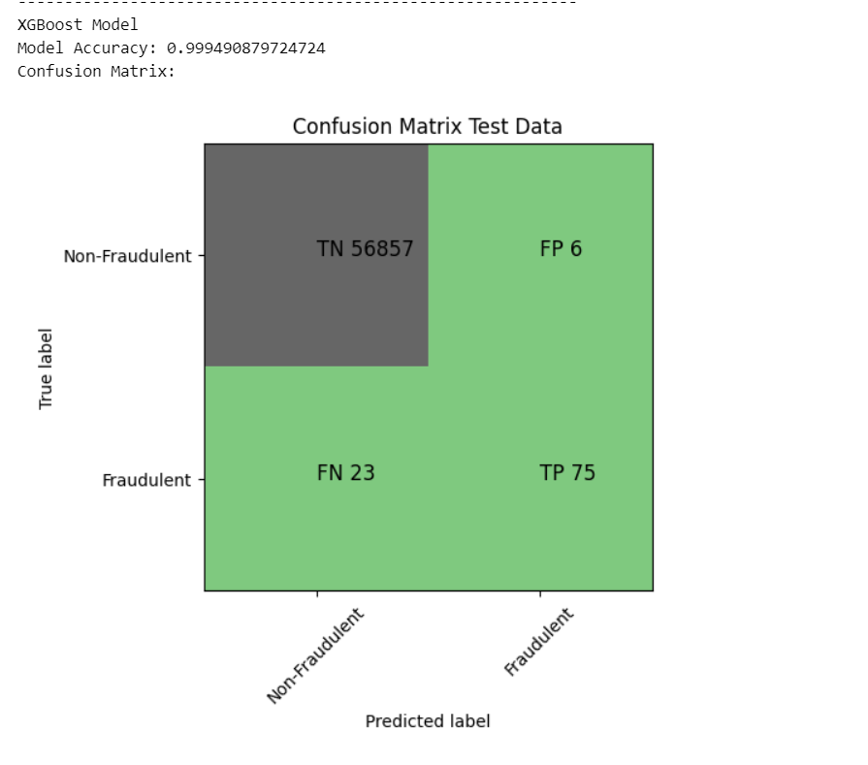
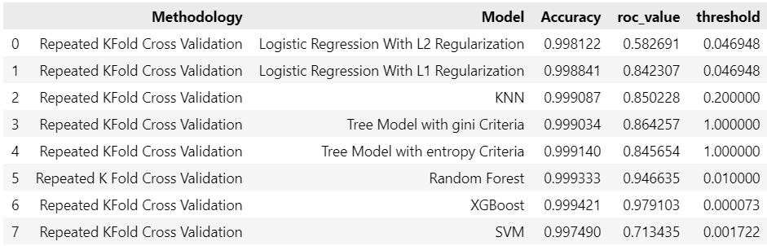
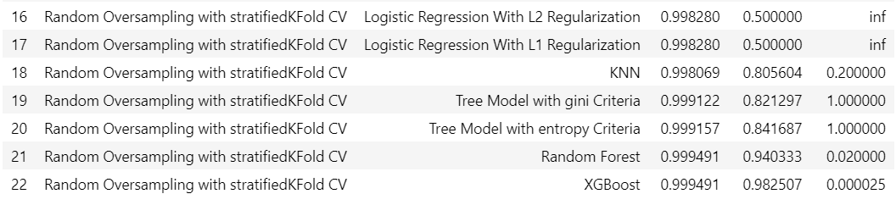
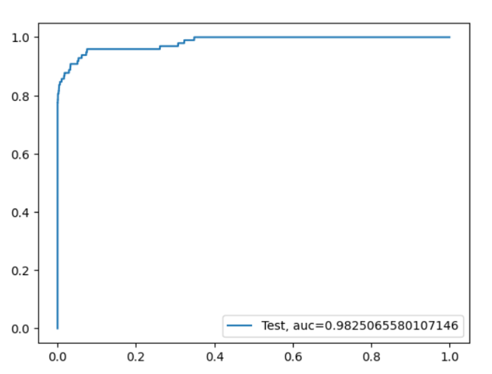
Random Oversampling with StratifiedKFold CV

Slide 12
Hyperparameter Optimization Process:
Define Hyperparameter Space: Set ranges for key parameters controlling model complexity.
2. Conduct Randomized Search: Use RandomizedSearchCV for efficient exploration.
3. Choose Evaluation Metric: Select ROC-AUC to measure model's discrimination ability.
4. Obtain Optimal Hyperparameters: Maximize ROC-AUC on validation data for parameter selection.
5. Evaluate Model Performance: Assess tuned XGBoost model with metrics like ROC-AUC Score.
6. Conclude Effectiveness: Highlight improved fraud detection accuracy post-tuning.

Slide 13
Results Slide (Model Performance)
Performance Comparison
1
Side-by-side bar charts and line graphs showcase the performance of various machine learning models, including Logistic Regression, Random Forest, and XGBoost, across key metrics like accuracy, precision, recall, and F1-score.
2
Hyperparameter Tuning
A detailed diagram or flowchart illustrates the process of hyperparameter tuning for the XGBoost model, highlighting the steps involved in identifying the optimal set of parameters to boost its performance.
Optimal Hyperparameters
3
A concise table or list presents the optimal hyperparameters for the XGBoost model, such as the learning rate, max depth, number of estimators, and regularization parameters, which were determined through the tuning process.
4
Model Performance
The performance of the tuned XGBoost model is showcased through a Receiver Operating Characteristic (ROC) curve, the area under the curve (AUC) score, and a clear confusion matrix, providing a comprehensive evaluation of its ability to accurately detect fraudulent transactions.

Slide 14



Practical Applications
Fraud Prevention
Customer Protection
Financial Integrity
The developed model can be integrated into real-time transaction monitoring systems to detect and prevent fraudulent activities.
Accurate fraud detection helps enhance customer trust and security, fostering a safer financial environment.
The model contributes to mitigating losses due to fraudulent transactions, safeguarding the financial sector.

Slide 15

Challenges and Limitations
1
Imbalanced Dataset
2
Hyperparameter Tuning
The highly skewed distribution of fraudulent and non-fraudulent transactions posed a significant challenge.
Optimizing the XGBoost model's hyperparameters required extensive experimentation and computational resources.
3
Adaptive Fraud Techniques
Continuously evolving fraud methods necessitate ongoing model updates and improvements.

Slide 16

Future Directions
Automated Tuning
Ensemble Methods
Advanced Feature Engineering
Implementing automated hyperparameter optimization techniques to streamline the tuning process.
Exploring ensemble learning approaches to leverage the strengths of multiple classifiers.
Investigating more sophisticated feature engineering techniques tailored to credit card transactions.

Slide 17

Top Performing Model
XGBoost
ROC-AUC Score
The XGBoost model, combined with random oversampling and StratifiedKFold cross-validation, consistently outperformed other models.
The tuned XGBoost model achieved an impressive ROC-AUC score of 0.9815, demonstrating its exceptional fraud detection capabilities.
Hyperparameter Tuning
Optimizing the XGBoost model's hyperparameters further enhanced its predictive performance.

